Slide 1
Presentation of AUGA group

Slide 2

The AgTech developer and more sustainable organic food producer.

Slide 3
Mission
food with no cost to nature.
Vision
a synonym for sustainable food and lifestyle.

Slide 4
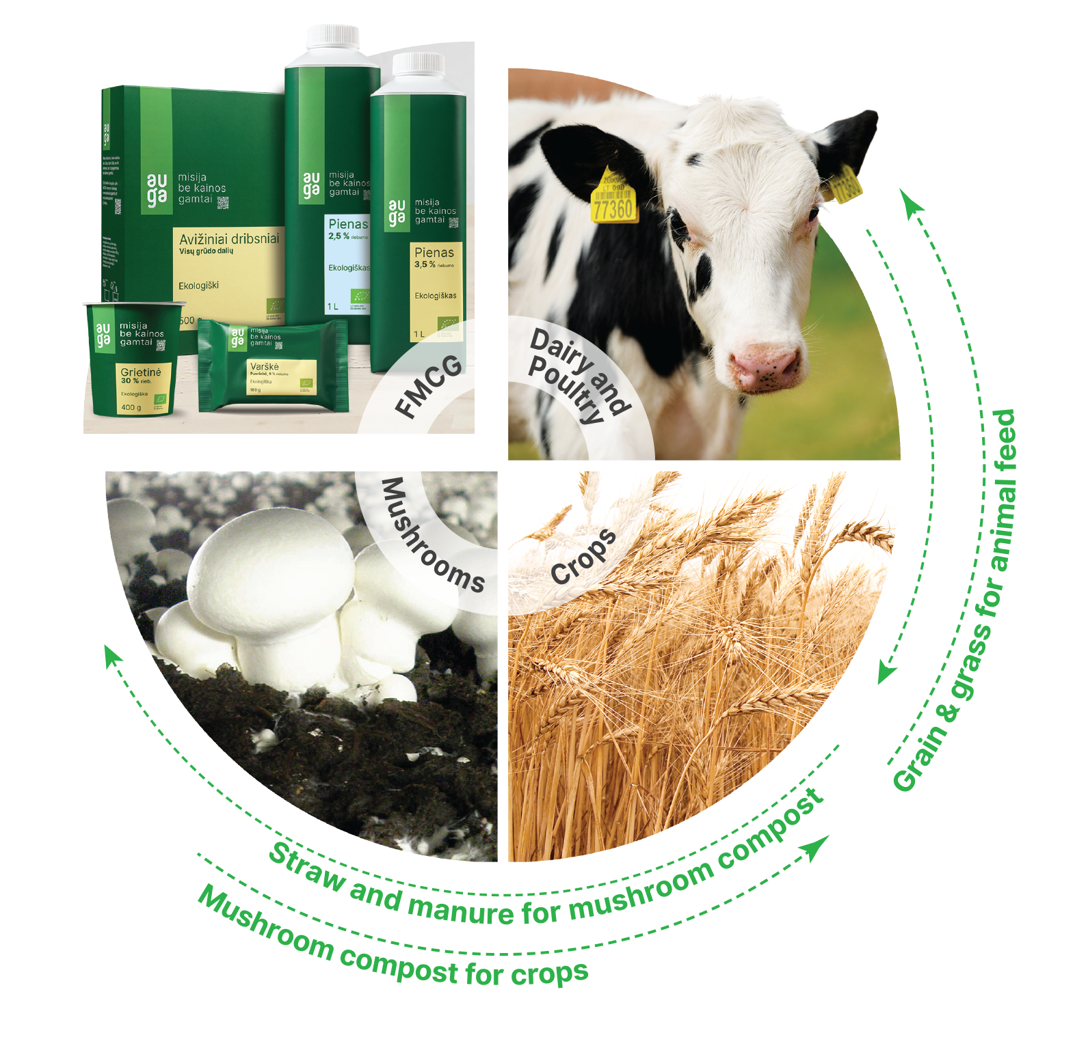
AUGA group at a glance
The largest vertically integrated organic food producer in Europe
Founded in
2014
Listed on
Nasdaq
Vilnius
38.5
of arable land
4+1
business segments
1,226
employees
th.
ha
80.1
revenue
66
of sales is export
million
EUR
%
Audited financial results, 2022​

Slide 5

Crop growing
Crops cultivated on 38,500 ha of certified organic arable land: wheat, oats, legumes, rapeseed, sugar beets, and vegetables.
86,000 t of crop production sold.
To ensure sustainable agriculture practices, the company applies regenerative crop rotation,min-till technologies, and innovative agricultural machinery.
Audited financial results, 2022​

Slide 6
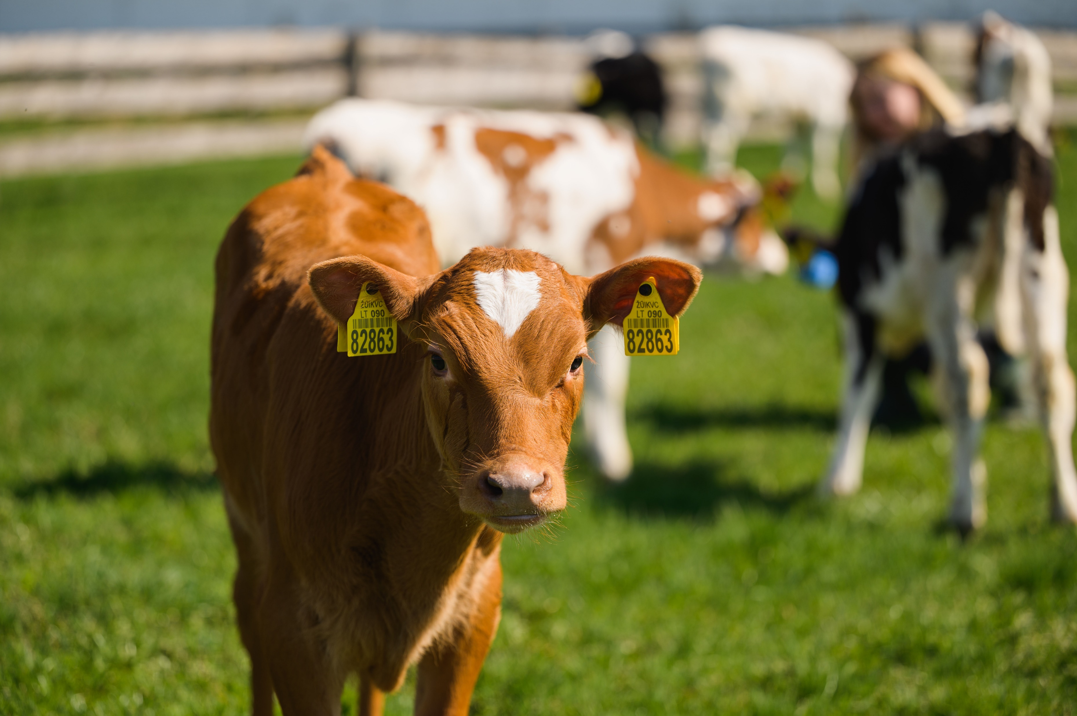
Dairy
3,400 dairy cows.
26,600 t of milk sold.
Cow feed is based on perennial leguminous grasses.
Livestock waste is used as an organic fertiliser, in a closed-loop organic farming model.
The manure is used for biomethane production.
Audited financial results, 2022​

Slide 7
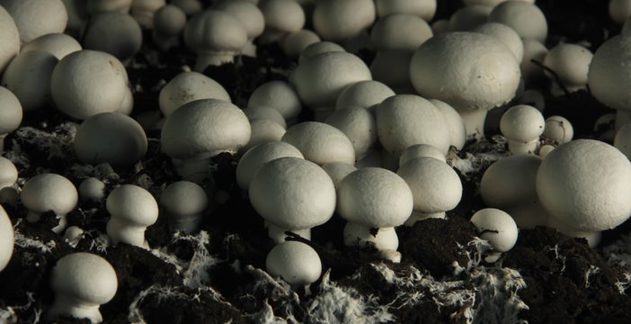
Mushroom growing
Approx. 12,000 t of mushrooms are grown annually.
11,500 t of mushrooms are sold.
Baltic Champs, a division of AUGA group, is one of the biggest and most advanced mushroom producers in the Baltic region.
The products are primarily exported to Sweden, Denmark, Norway, Latvia, and Estonia.
Audited financial results, 2022​

Slide 8

Food basics for consumers
Everyday consumer food basics: milk kefir, curd, sour cream, oatflakes, and eggs.
Produced exclusively from organic raw materials from AUGA farms, which are committed to sustainable farming practices.
A new category in food.
mission no cost to nature
On July 21, 2023, AUGA group signed a contract completion document for the sale of the company Grybai LT to Kauno grūdai. Grybai LT produces organic ready-to-eat products such as soups, canned vegetables, stews, and grain bowls.

Slide 9
AUGA group’s sustainability-focused strategy

Slide 10
Agriculture is responsible for 22% of global emissions
Buildings and other
Transport
Energy
Agriculture
Industry
Source: The Intergovernmental Panel on Climate Change at the United Nations report (2022), data for the year 2019

Slide 11
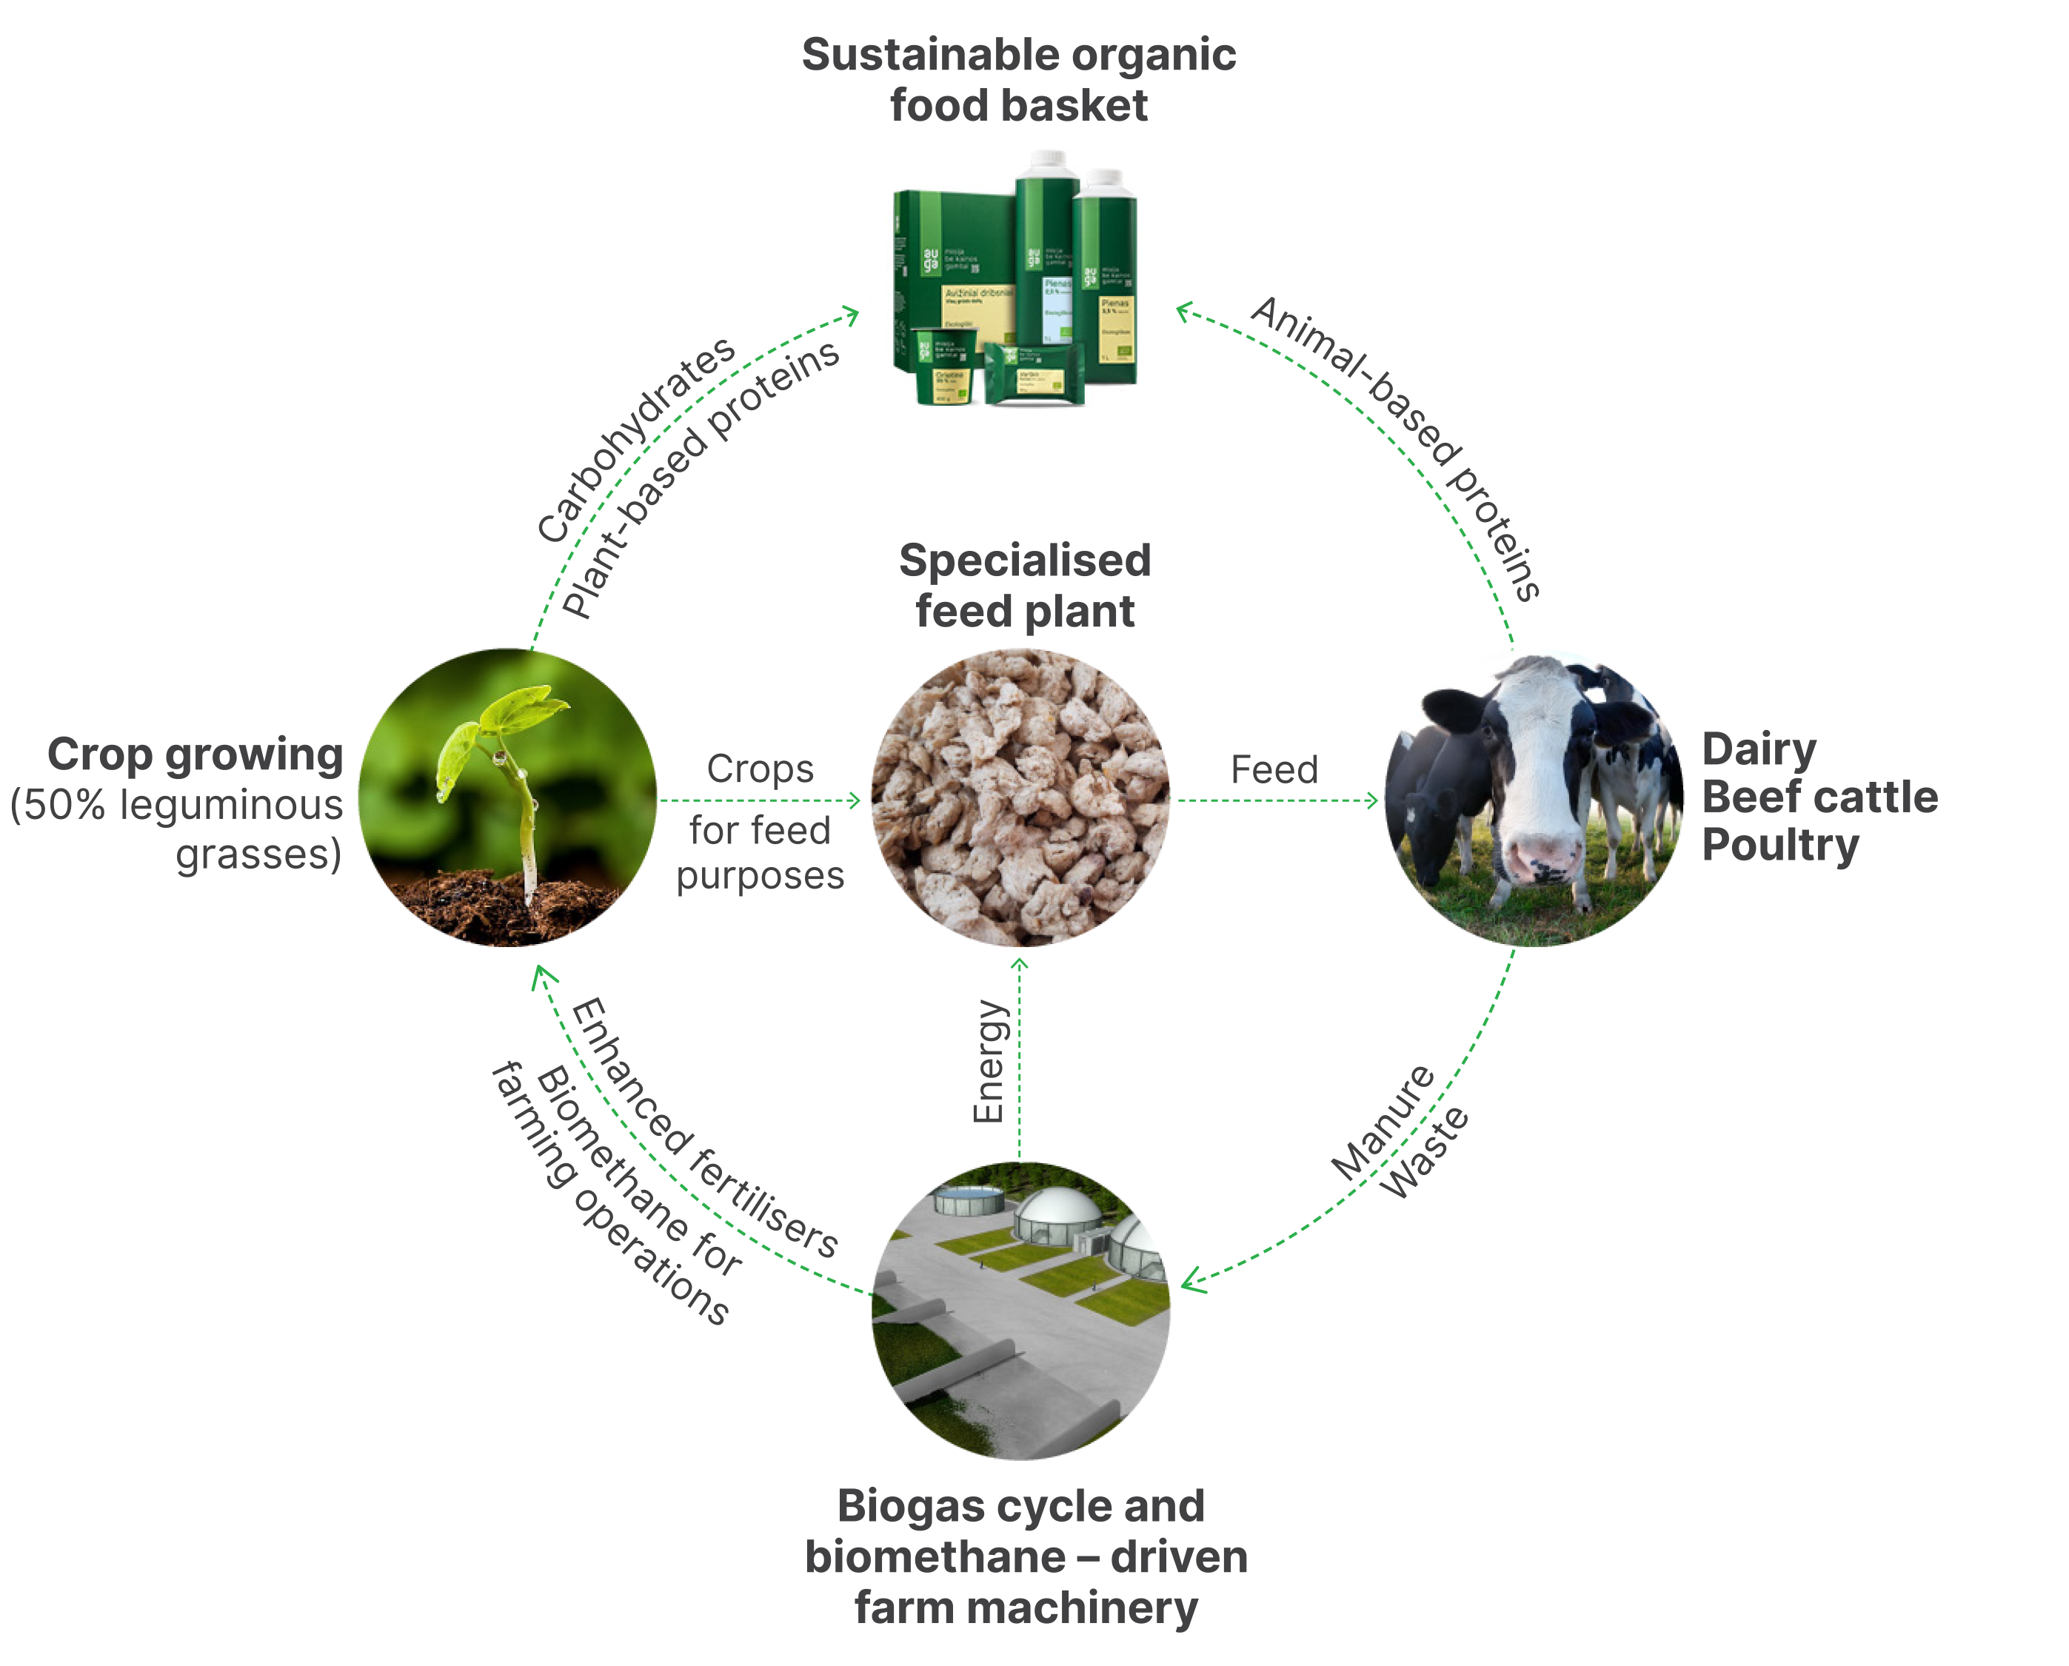
AUGA’s solution: SOFA
(Sustainable Organic Farming Architecture)
Emission-reducing technologies for agriculture:
biogas cycle infrastructure and vehicles,
specialized feed technology,
regenerative crop-rotation.
This will address the > 90% emissions generated by AUGA group activities.
Once the technology cycle is complete, AUGA group will be able to achieve net-zero target by 2030.

Slide 12
GHG reduction goals by 2025
50%
less emissions from fossil fuel use on farms which is replaced by biomethane.
50%
less emissions per one tonne of cow's milk, using specialized feed technology.
30%
less emissions from agricultural dry matter yield per tonne, using the perennial legume crop rotation method.

Slide 13
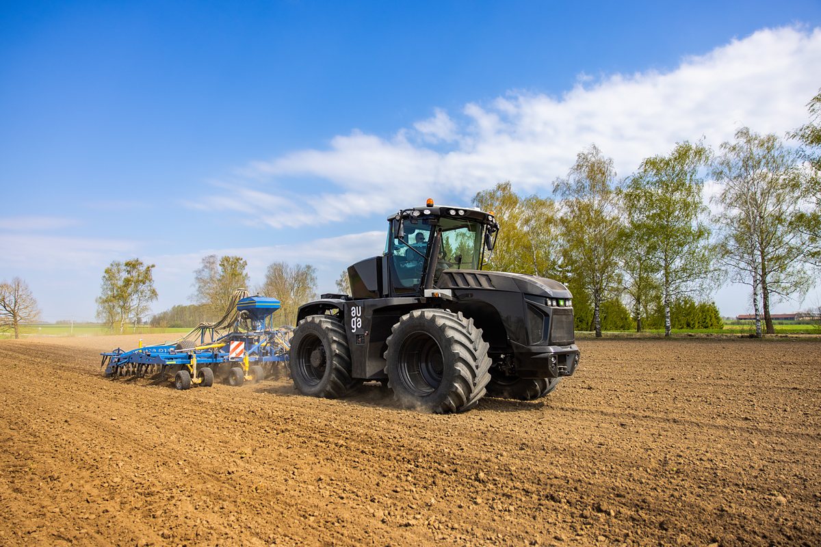
AUGA achievements in AgTech
First production models of AUGA M1 tractors are now at the field- testing stage.
AUGA’s unique biomethane processing and delivery cycle is operational.
Specialised feed technology that will reduce methane emissions from cattle is at prototype stage and shows promising results.
Sustainably powered agricultural machinery for other essential farming operations is under development.
The amount of diesel fuel saved in one busy month when you use our AUGA M1 tractor is equivalent to that used in the entire lifetime of a diesel-powered passenger car.

Slide 14
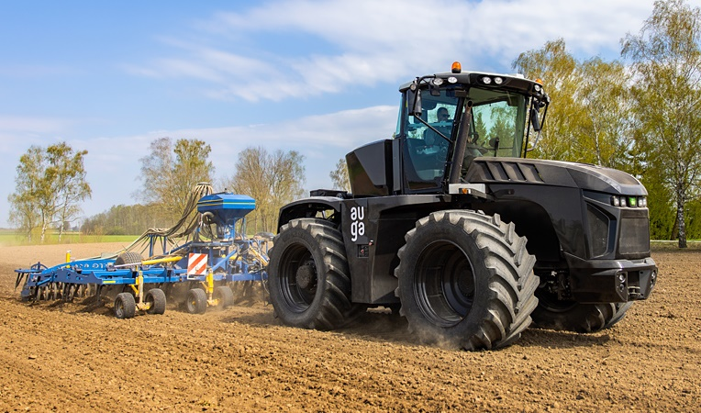

AUGA business model
AUGA Community
Sustainable Technology Provider
Sustainable Technology Provider
Sustainable Farming Operations
Sustainable
Food
Basics
Sustainable Farming Operations
AUGA Tech
AUGA SOFA
AUGA Trade
Identifying emissions problems in farming.
Creating solutions.
Developing and scaling technology.
Sustainable farming standards and certification.
Organisational structure for technology sharing.
Know-how and digital farm management tools for farmers.
Brand marketing.
AUGA-led contract manufacturing.
Co-branding and AUGA sustainability labels.

Slide 15
AUGA business model
AUGA Community
Sustainable Technology Provider
Sustainable Technology Provider
Sustainable Farming Operations
Sustainable
Food
Basics
Sustainable Farming Operations
AUGA Tech
AUGA SOFA
AUGA Trade
Cooperatives
Other farmers
AUGA farms
Other farmers
AUGA farms
Other farmers

Slide 16
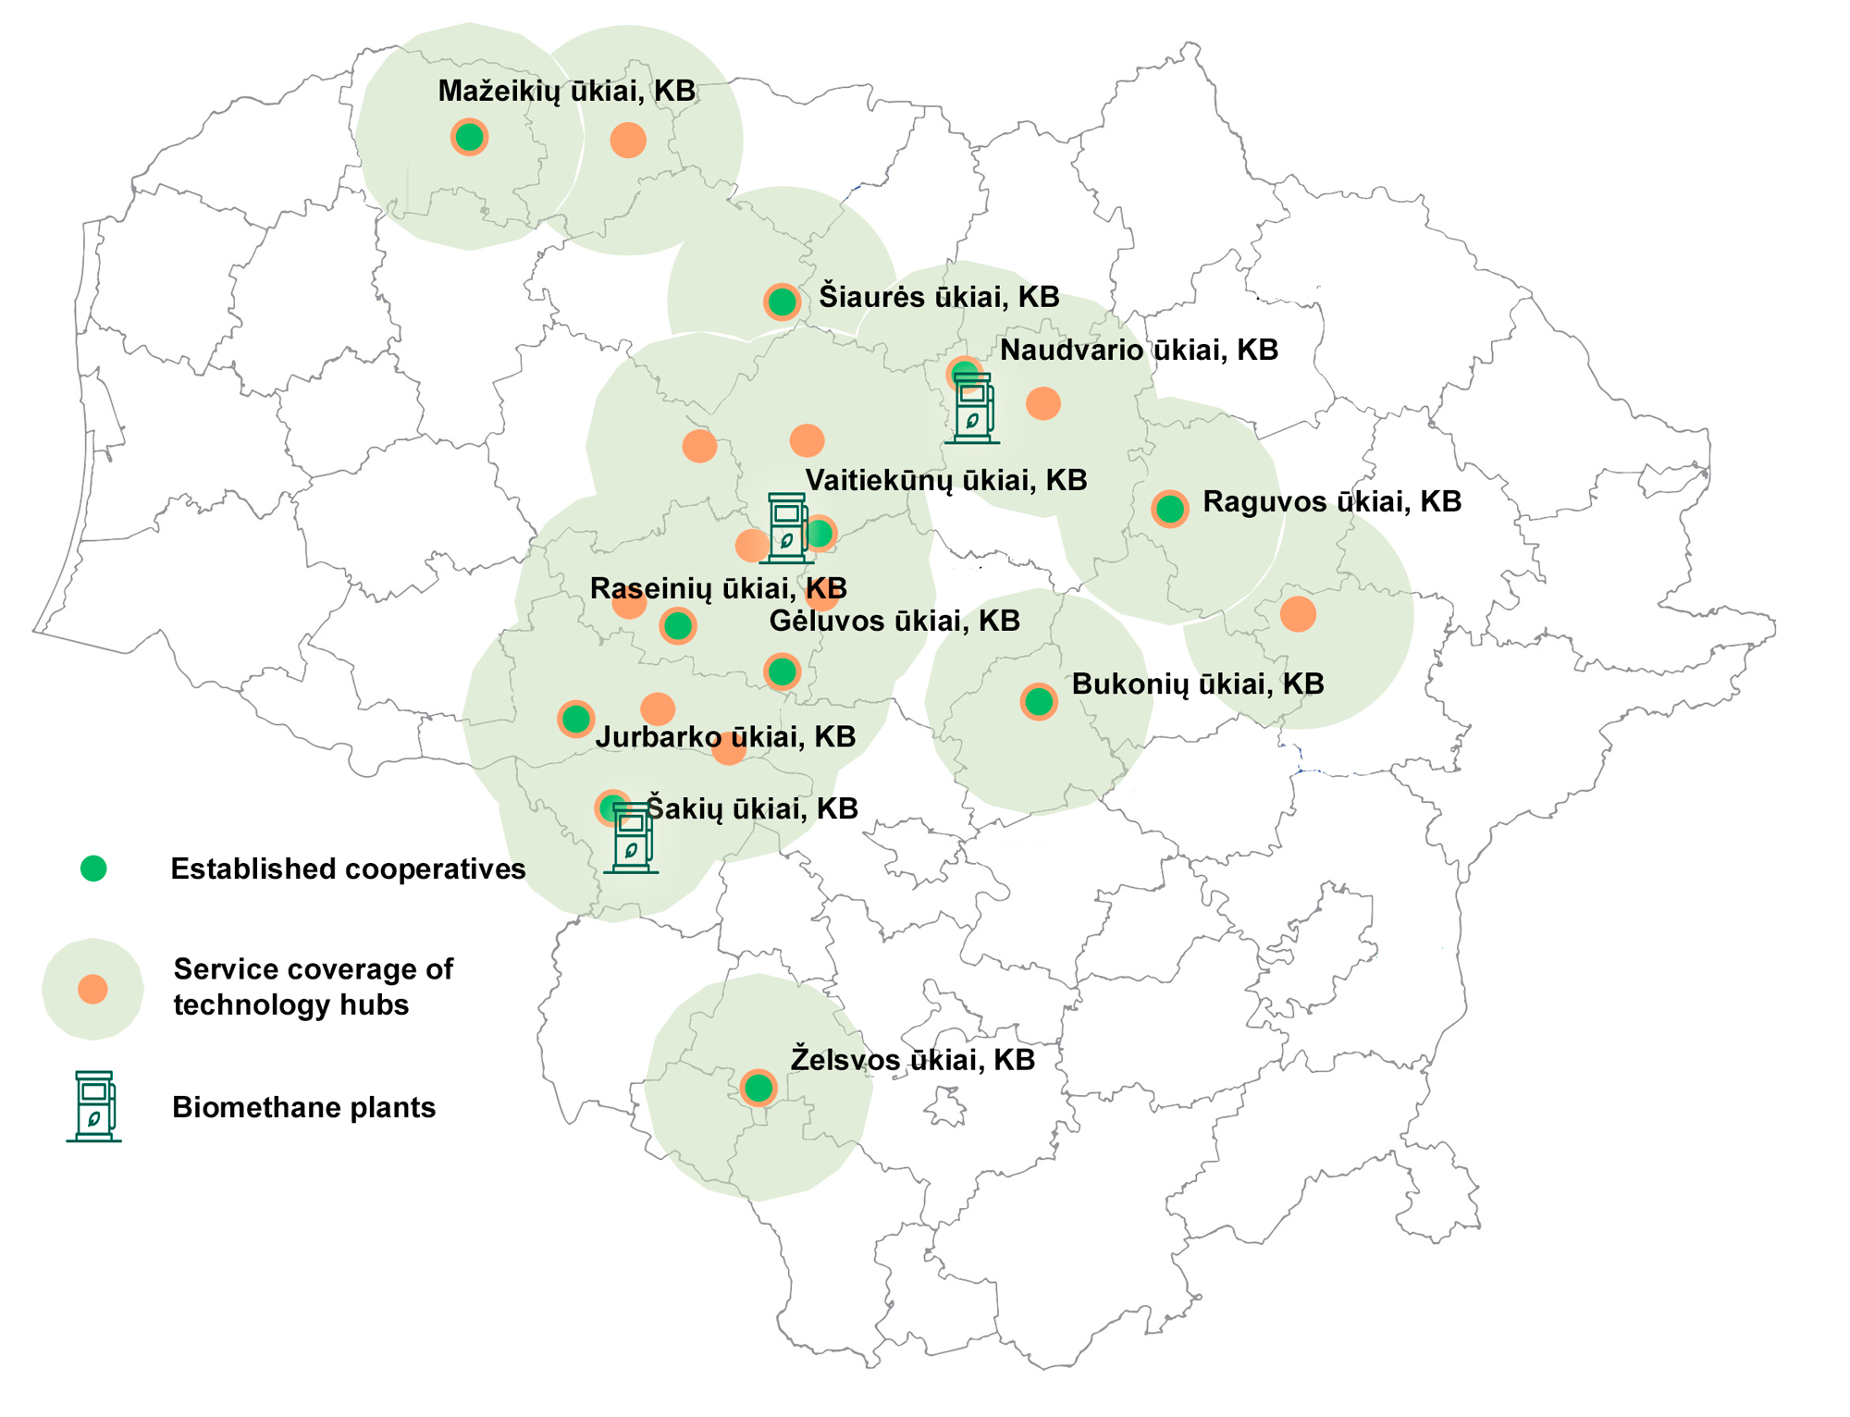
How it works in Lithuania
11 regional cooperatives.
3 biomethane plants.
21 technology hubs that can extend their coverage from the current 38 000 ha to 750 000 ha of farmland (servicing farmers in 25% of the territory of Lithuania)

Slide 17




The future of AUGA
Food with no cost to nature
CONSUMERS
FARMERS
PRIVATE AND INSTITUTIONAL INVESTORS
SHAREHOLDERS
a more sustainable way to eat
a more sustainable way to work
a more sustainable way to invest
a more sustainable way to receive financial returns

Slide 18
SYNONIM FOR
SUSTAINABLE FOOD AND LIFESTYLE

